Slide 1
CAPSTONE PROJECT – CSE4099 Stock Analysis and Prediction using scraped news articles on a Deep Learning architecture Review 2
By – Ronet Swaminathan
Reg. No.- 16BCE1166
Project Guide – Prof. Sridhar R.

Slide 2
Problem Statement
To solve real world scenario of predicting stock market using new articles from the Internet.
We do not always have a good dataset to know about the details of the stock market, and here predicting using news articles can be a very effective way to gain fast and effective insights.

Slide 3
Project Objectives
Scrape textual news data and historical numerical stock data for a period of time from the internet using frameworks like BeautifulSoup, Selenium etc.
To predict stock movement using the mined text data, do analytics on it and provide deeper insights simply not possible through numerical values.
Apply transfer learning between textual and numerical datasets.
To make sense of numerical stock data and predict using textual news data by incorporating algorithms of sentiment analysis and deep learning.
Try to extend the project to use real-time stream data.

Slide 4
Proposed System
We can see a pattern here - several studies have been done in the past to cumulate data from news sources and make predictions through it. The most popular use case is sentiment analysis where one can create surveys about user sentiments and use it to gain insights in political, business and educational domains.
In the recent time, with the boom of social media, it is becoming easier to collect user data. For eg., Facebook and Twitter publish some open user data every year for developers to make analysis on it (APIs). This was indeed the case when researchers at Facebook and Twitter partnered with US Security Forces, were analysing through individual posts in Syria to identify objectional content. This was done to screen out potential terrorists and curb terrorist activities.
With such advances in mind, I look to implement a similar function to a business-related problem, mainly building a deep-learning based stock prediction mechanism using data from textual news articles.

Slide 5
Proposed System (contd.)
In this project, I propose to create an analysis cum prediction model to assess stock movements through scraping news articles. Here, I will be scraping stock related news articles, general business articles for certain companies whose stocks are prominent etc. I will then also scrap historical data of these company stocks from a finance website.
So, I will be working with a mixture of textual as well as numeric data. This will correspond to 2 different datasets. Now there will be a propagation of knowledge between the datasets, where I plan to use sentiment analysis on the textual data and use that to predict a “mood” index, which in turn will decide how the next day stock forecast will change.

Slide 6
Proposed System (contd.)
Previous works have already made prediction models for this problem, but there, stocks have been previously updated and predicted using a time series model where there is a continuous stream of daily highs and lows for a given number of stocks over a period of time using conventional machine learning models.
The novelty in my work is that I am using 2 completely different parameters to predict stocks, that are news as well as time series. This model will then be trained over a neural net using TensorFlow.

Slide 7
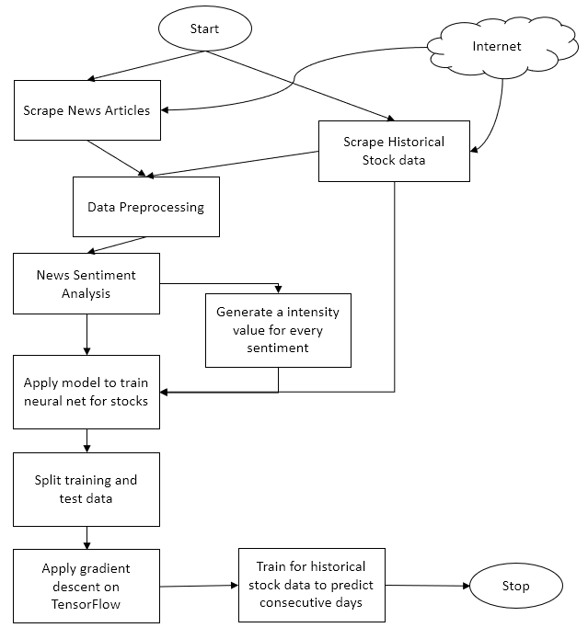
Engineering Design
A flowchart that simplifies the architecture of the project.

Slide 8
Technical Implementation steps taken (Till Review 1)
Literature surveys done to know the state of existing works in the field.
Historical stock data has been scraped from websites like Quandl and Yahoo Finance. The stocks are dated from 2012 to 2018 (i.e. 5 years of stock data)
Analytics has been done on the extracted stock data. Several statistics like risk and return trends, moving average and correlation measures have been deduced.
Following are some of the graphs and related code that has been implemented.

Slide 9
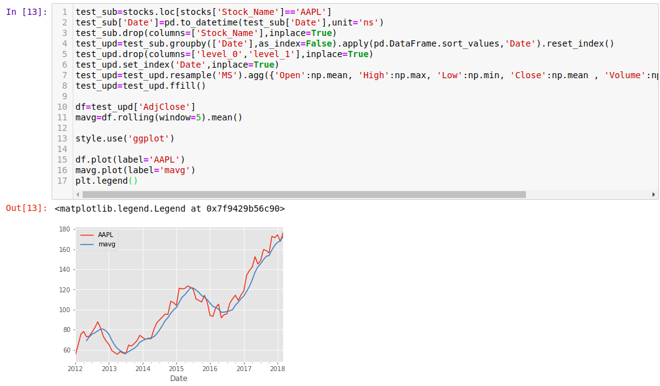
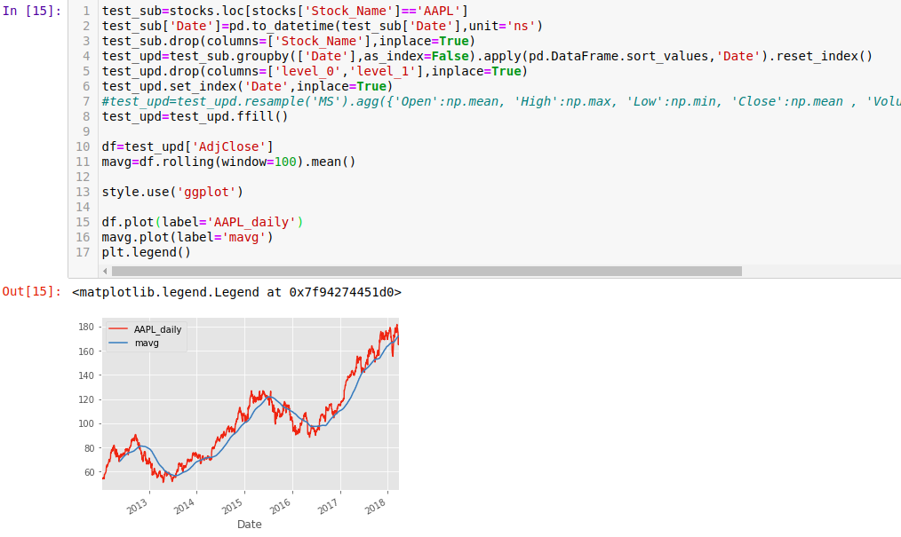
Apple Stock trend – resampled by month and through moving average with rolling window = 5
Apple Stock trend – preprocessed raw from scraped data and its moving average with rolling window = 100

Slide 10
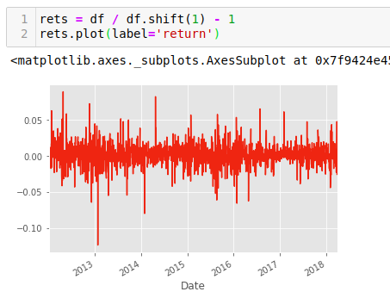
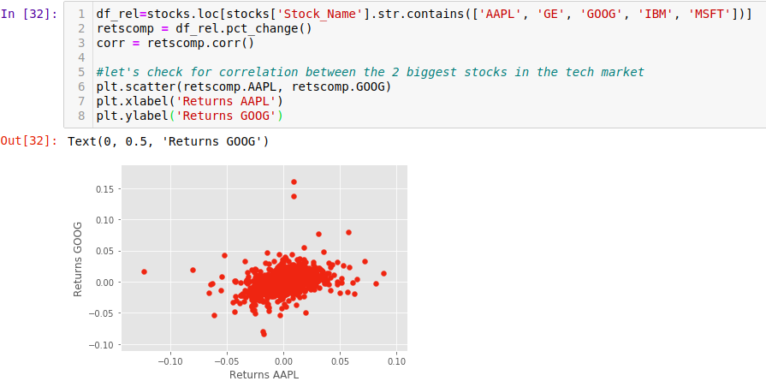
Apple Stock trend – returns graphed for the scraped time period by standardized formula
Correlation between Apple and Google stock

Slide 11
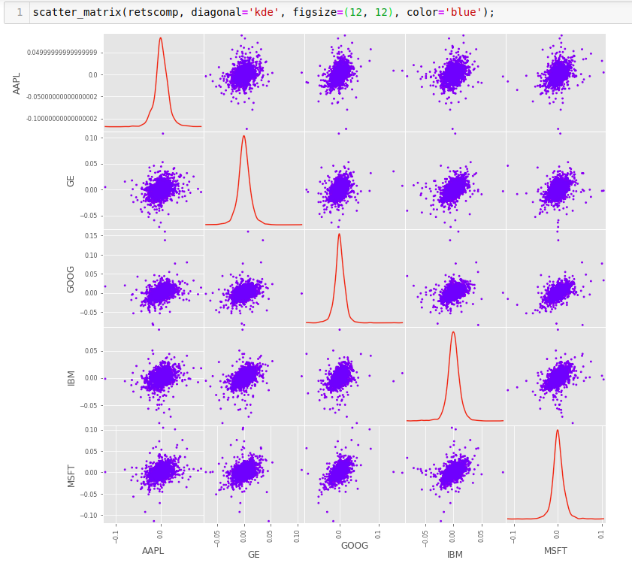
Correlation Scatter Matrix between the dominant stocks

Slide 12
Text News Extraction
Collected data from Reuters and NASDAQ, 2 very popular websites producing finance and stock news.
Used BeautifulSoup to scrape the web pages and stored them into csv files.
Files named “date” wise, containing all the news published that day by the news sources.
Each file will have atleast 1 news of 1 stock ticker.
Not necessary that each each will have some news on a daily basis

Slide 13
Data Preprocessing
Longest part of the entire project timeline. Still under revisions.
Rescaled numerical stock data to smaller dimensions, removing all redundant columns thus, leading to dimension reduction from 14 to 8.
Final stock data used for analytics contains the following columns : [Date, Symbol, High, Low, Open, Close, Volume and AdjClose]
Cleaned text news off random ads by filtering out unnecessary keys in JSON during scraping.

Slide 14
Data Preprocessing (contd.)
After curating legible news articles, we then move onto processing that news.
For this, we will use sentiment analysis to calculate a normalized score and a magnitude score.
Derived a formula for sentiment magnitude, along with a scaling factor. Preprocessed data for various alphas.
As discussed back in review 1, this will help in measuring each news articles to determine “what type” of sentiment and “how much” of that sentiment.
This ultimately will help us calculate our loss function for the deep neural network.

Slide 15
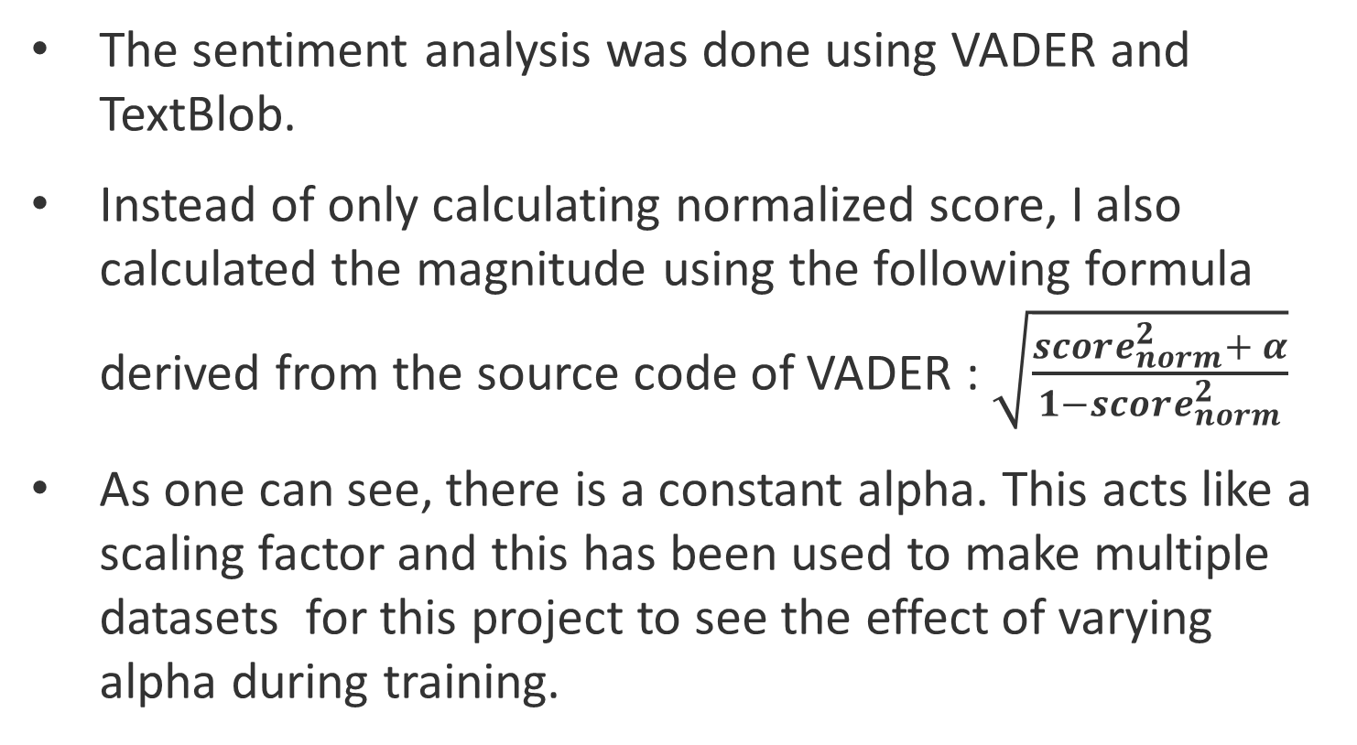
Data Preprocessing (contd.)
The sentiment analysis was done using VADER and TextBlob.
Instead of only calculating normalized score, I also calculated the magnitude using the following formula derived from the source code of VADER : $\sqrt{\frac{score_{norm}^{2}+ α}{1−score_{norm}^{2}}}$
As one can see, there is a constant alpha. This acts like a scaling factor and this has been used to make multiple datasets for this project to see the effect of varying alpha during training.

Slide 16
Data Preprocessing (contd.)
Upon calculation of all the necessary features, we will then need to assimilate everything into a single dataset.
Thus, I took all the [ticker symbols, date, open, close] features into a separate dataframe and appended it with the features extracted from sentiment analysis.
To preserve the order of date, we took a datetime.timetuple() and extracted the day number of the year using the tm_yday parameter.
Therefore, the final processed dataset before training is of the shape (21286,6)

Slide 17
Machine Learning Models
Baseline testing – Though our aim is to set this project on a deep learning model, we created some machine learning regression models to get a baseline measurements.
This will help us to fine tune our DNN to achieve realistic and great RMSE (metric used here) values.
As DNN work on a somewhat different principle, we will be focusing on loss and cost function minimization.

Slide 18
Machine Learning Models (contd.)
For the purpose of setting a benchmark, 4 regression models were used.
They are : Linear Regression, Support Vector Regression, Random Forest Regression and Gradient Boost Regression.
Here are the results of a single run, with train test split in the ratio 70 : 30. The models were tested on 2 types of pre processed datasets, one that was simply label encoded and the other that was one hot encoded to take into account the stock tickers as well.

Slide 19
Performance Analysis
As we can see, there is a trend that says one hot encoded data usually gives better accuracy.

Slide 20
Other work done
Worked on the draft of the research paper, to be submitted in a respectable SCOPUS rated journal.
Started developing the neural network code, needs fault testing.
Extensive comparison and experimentation for paper.
Completing rough draft of the project thesis.

Slide 21
THANK YOU

